Slide 1
Project Defense on
Luxx Time: Online Watch Store
Presented by: Tsewang Rabten

Slide 2
Introduction
“Luxx Time” is an online platform designed to make shopping for watches easy and convenient.
It usually provides detailed product descriptions, high-quality images, and reviews from other customers.
It also makes purchasing a watch simple and secure.

Slide 3
Problem Statement
One of the biggest issues is the large variety of watches available, which can overwhelm customers and make it difficult for them to find the right watch.
Even with detailed descriptions and images, shoppers may still feel unsure about their purchase, increasing the risk of returns.

Slide 4
Objectives
To build a system that provide secure and convenient payment process.
To build a system that is user friendly for customer shopping on watches.

Slide 5
Development Methodology
Waterfall Model
Aim of using this approach is we can focus on each part of the model during the development and come back to it if need be. The project can be easily be broken down into different parts based on this model.
This system is easy to manage because it easy to understand and user friendly so every common user can use it easily.
This system is smooth service and security to the customer

Slide 6
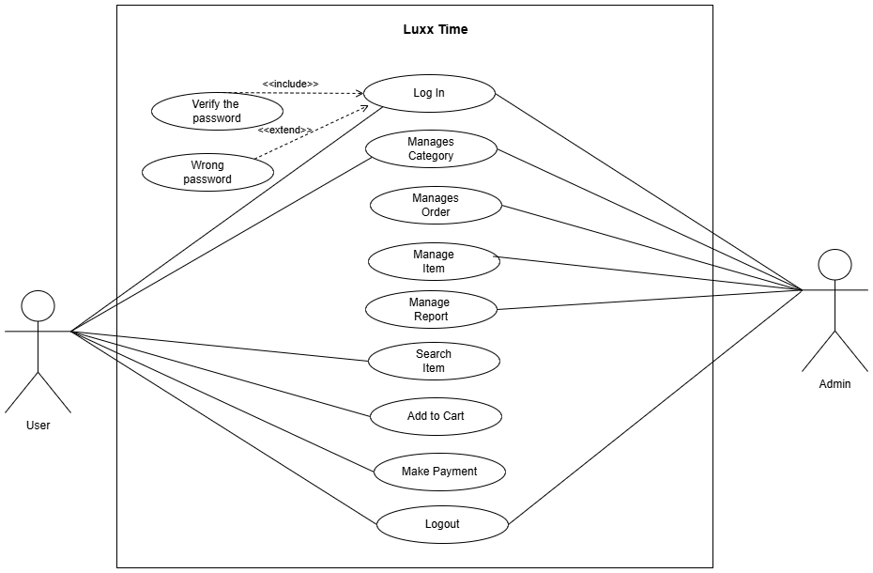
Use case Diagram

Slide 7
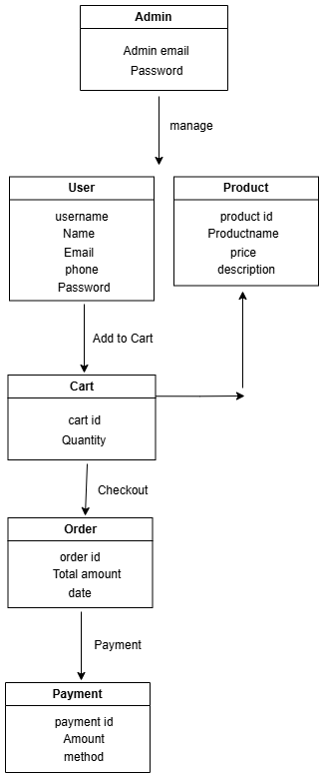
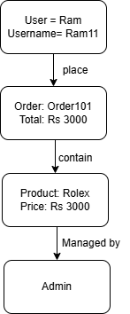
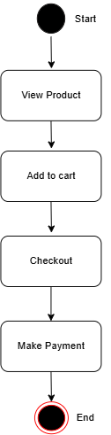
Class Diagram
Object Diagram
State Diagram

Slide 8
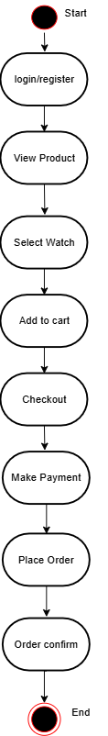
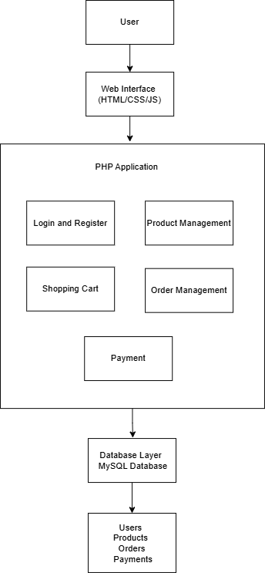
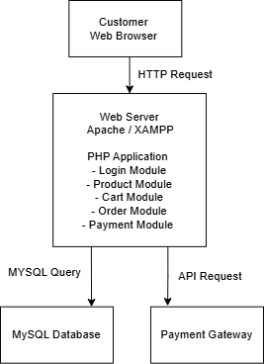
Activity Diagram
Component Diagram
Deployment Diagram

Slide 9
Algorithm
Content Based Filtering
Content-Based Filtering recommends products by analyzing the attributes of items that a user has shown interest in, such as their features, categories, or styles. If a user likes a certain type of product, the system recommends similar products based on the attributes of those items.
This algorithm that suggests products to users based on the characteristics of items they've previously interacted with or shown interest in.
Item Profile Creation
User Profile Creation

Slide 10
Conclusion
Luxx Time offers a convenient and efficient way for customers to browse, compare, and purchase a wide variety of watches from the comfort of their homes. With easy access to different brands, styles, and price ranges, shoppers can find the perfect watch to suit their needs and preferences.

Slide 11
Thank You

